Slide 1

MS SQL 2012 Database Administration Training by Sholla Corporation
8204 Fenton Street
Silver Spring, MD 20910

Slide 2
MS-SQL 2012 Database Administrator
Part II
Chapter III

Slide 3
MS-SQL 2012 Database …
Course Content :
Part II. MS SQL Database Design, Development and Administration
Introduction to Relational Database Management System

Slide 4
Relational Database Management System Management (RDBMS)
Database is
collection of related data and its metadata organized in a structured format
for optimized information management
Database Management System (DBMS) is
a software that enables easy creation, access, and modification of databases
for efficient and effective database management
Database System is
an integrated system of hardware, software, people, procedures, and data
that define and regulate the collection, storage, management, and use of data within a database environment

Slide 5
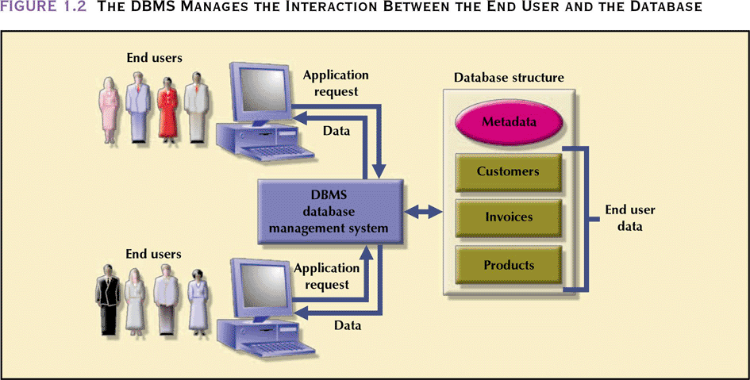
Database Management System
Manages interaction between end users and database

Slide 6
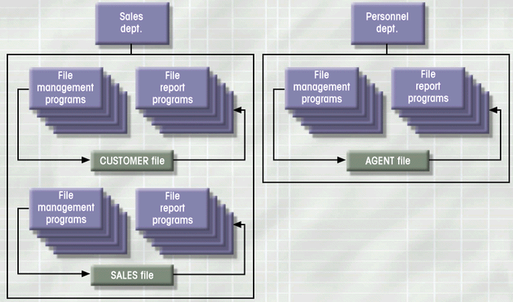
File System: Example

Slide 7
File System: Weakness
Weakness
“Islands of data” in scattered file systems.
Problems
Duplication
same data may be stored in multiple files
Inconsistency
same data may be stored by different names in different format
Rigidity
requires customized programming to implement any changes
cannot do ad-hoc queries
Implications
Waste of space
Data inaccuracies
High overhead of data manipulation and maintenance

Slide 8
File System: Problem Case
CUSTOMER file
AGENT file
SALES file
A_Name (15 char)
A_Name (20 char)
AGENT (20 char)
Carol Johnson
Carol T. Johnson
Carol J. Smith
- inconsistent field name, field size - inconsistent data values - data duplication

Slide 9
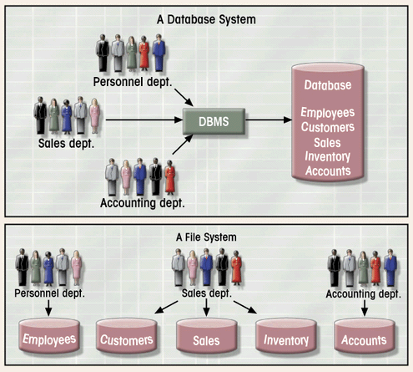
Database System vs. File System

Slide 10
Database: Why
Purpose of Database
Optimizes data management
Transforms data into information
Importance of Database Design
Defines the database’s expected use
Avoid data redundancy & ensure data integrity
data is accurate and verifiable
Poorly designed database generates errors
leads to bad decisions
can lead to failure of organization

Slide 11
Database: Why
Functions of DBMS/Database System
Stores data and related data entry forms, report definitions, etc.
Hides the complexities of relational database model from the user
facilitates the construction/definition of data elements and their relationships
enables data transformation and presentation
Enforces data integrity
Implements data security management
access, privacy, backup & restoration

Slide 12
Database: How
Identify
Database needs :what database can do to further the goal of the organization
User needs and characteristics: who the users are, what they want to do, how they envision doing it
Database system requirements: what the database system should do to satisfy the database and user needs
Design
From conceptual design to a detailed system specification
Implementation
Create the database
Maintenance
Troubleshoot, update, streamline the database

Slide 13
RDBMS Design and normalization
Normalization
Process for evaluating and correcting table structures to minimize data redundancies
Reduces data anomalies
Works through a series of stages called normal forms:
First normal form (1NF)
Second normal form (2NF)
Third normal form (3NF)
2NF is better than 1NF; 3NF is better than 2NF
For most business database design purposes, 3NF is as high as we need to go in normalization process
Highest level of normalization is not always most desirable

Slide 14
Normalization
Each table represents a single subject
No data item will be unnecessarily stored in more than one table
All attributes in a table are dependent on the primary key
Why is this flat table very resource intensive (look at this from OLTP (Online Transactional Processing) Vs Reporting Database point)?
Reg | Std_ID | F_Name | M_Name | L_Name | S_Adds | City | Zip | Primary_ Email | Secondary_Emial | Primary_Phone | Secondary_ Phone | Course# | Course Name | Credit hour | Contact_Hr | Inst_ID | Inst_F_name | Inst_LName | Inst_Primary_Phne | Inst _Primary_email
01101 | 001 | Maya | Z | Max | 1234 N F | xxx | 001 | 0012112122 | 111@gg.c | 22222222 | 333333 | 144 | SQL Amin | 8 | 8 | 035 | Peter | Sima | 32546544 | Peter…
01102 | 002 | Alex | B | Ben | 324 DT | xxx | 035 | 01325465 | 11231@g.c | 1111111 | - | 144 | SQL Amin | 8 | 8 | 035 | Peter | Sima | 32546544 | Peter…
01103 | 003 | Del | H | Adam | 3231 kl | xxx | 112 | 011234598 | lkl@eu.net | 5655412 | - | 144 | SQL Amin | 8 | 8 | 035 | Peter | Sima | 32546544 | Peter…

Slide 15
RDBMS Design and normalization
Course# | Course Name | Credit hour | Contact_Hr
144 | SQL Amin | 8 | 8
144 | SQL Amin | 8 | 8
144 | SQL Amin | 8 | 8
Reg# | Std_ID | Course# | Inst_ID
01101 | 001 | 144 | 035
01102 | 002 | 144 | 035
01103 | 003 | 144 | 035
Inst_ID | Inst_F_name | Inst_LName | Inst_Primary_Phne | Inst _Primary_email
035 | Peter | Sima | 32546544 | Peter…
035 | Peter | Sima | 32546544 | Peter…
035 | Peter | Sima | 32546544 | Peter…
Std_ID | F_Name | M_Name | L_Name | S_Adds | City | Zip | Primary_ Email | Secondary_Emial | Primary_Phone | Secondary_ Phone
001 | Maya | Z | Max | 1234 N F | xxx | 001 | 0012112122 | 111@gg.c | 22222222 | 333333
002 | Alex | B | Ben | 324 DT | xxx | 035 | 01325465 | 11231@g.c | 1111111 | -
003 | Del | H | Adam | 3231 kl | xxx | 112 | 011234598 | lkl@eu.net | 5655412 | -

Slide 16
Normalization
Normalized
Std_ID | F_Name | M_Name | L_Name
001 | Maya | Z | Max
002 | Alex | B | Ben
003 | Del | H | Adam
Std_ID | Primary_ Email | Secondary_Emial | Primary_Phone | Secondary_ Phone
001 | 0012112122 | 111@gg.c | 22222222 | 333333
002 | 01325465 | 11231@g.c | 1111111 | -
003 | 011234598 | lkl@eu.net | 5655412 | -
Std_ID | S_Adds | City | Zip
001 | 1234 N F | xxx | 001
002 | 324 DT | xxx | 035
003 | 3231 kl | xxx | 112

Slide 17
Primary Key and Foreign Key
The PRIMARY KEY constraint uniquely identifies each record in a database table.
Primary keys must contain UNIQUE values, and cannot contain NULL values.
A table can have only one primary key, which may consist of single or multiple fields
A FOREIGN KEY is a key used to link two tables together.
A FOREIGN KEY is a field (or collection of fields) in one table that refers to the PRIMARY KEY in another table.
The table containing the foreign key is called the child table, and the table containing the candidate key is called the referenced or parent table.

Slide 18
ACID TEST
Transactions have the following four standard properties, usually referred to by the acronym ACID:
Atomicity: Ensures that all operations within the work unit are completed successfully; otherwise, the transaction is aborted at the point of failure, and previous operations are rolled back to their former state.
Consistency: Ensures that the database properly changes state upon a successfully committed transaction.
Isolation: Enables transactions to operate independently of and transparent to each other.
Durability: Ensures that the result or effect of a committed transaction persists in case of a system failure.

